Slide 1
PARTIAL DIFFERENTIAL EQUATIONS
Dr. Anirban Tarafdar
Amrita Vishwa Vidyapeetham, Faridabad

Slide 2
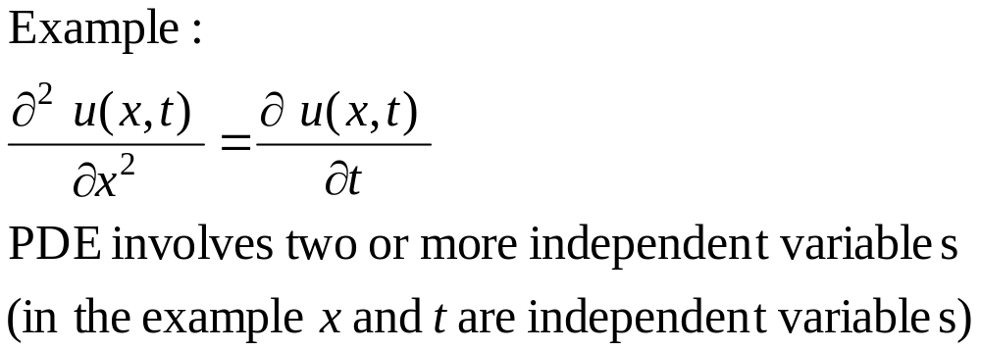
Partial Differential Equations
A partial differential equation (PDE) is an equation that involves an unknown function and its partial derivatives.

Slide 3
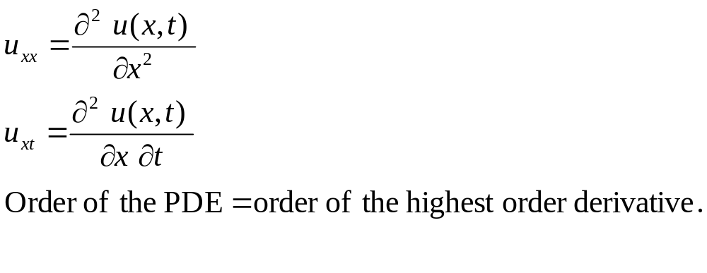
Notation

Slide 4
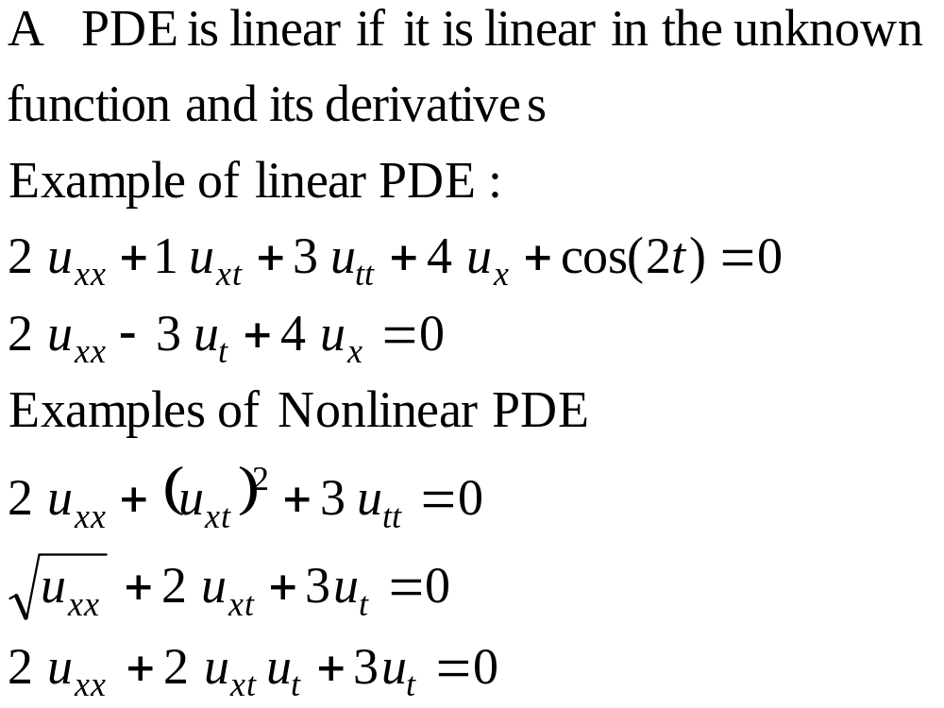
Linear PDE
Classification

Slide 5

Representing the Solution of a PDE
(Two Independent Variables)
Three main ways to represent the solution
T=5.2
t₁
T=3.5
x₁
Different curves are used for different values of one of the independent variable
Three dimensional plot of the function T(x,t)
The axis represent the independent variables. The value of the function is displayed at grid points

Slide 6
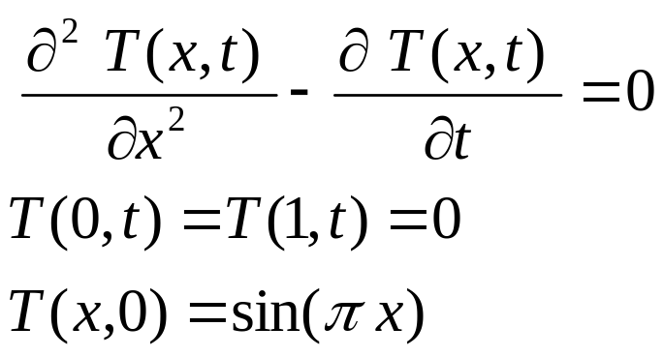
Heat Equation
Different curve is used for each value of t
ice
ice
Temperature
Temperature at different x at t=0
x
Thin metal rod insulated everywhere except at the edges. At t =0 the rod is placed in ice
Position x
Temperature at different x at t=h

Slide 7
Examples of PDEs
PDEs are used to model many systems in many different fields of science and engineering.
Important Examples:
  Laplace Equation
  Heat Equation
  Wave Equation

Slide 8
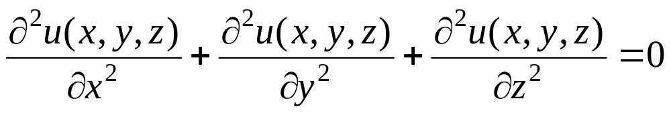
Laplace Equation
Used to describe the steady state distribution of heat in a body.
Also used to describe the steady state distribution of electrical charge in a body.

Slide 9
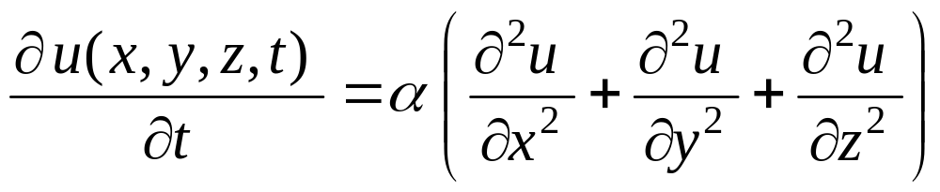
Heat Equation
The function u(x,y,z,t) is used to represent the temperature at time t in a physical body at a point with coordinates (x,y,z)
α is the thermal diffusivity. It is sufficient to consider the case α = 1.

Slide 10
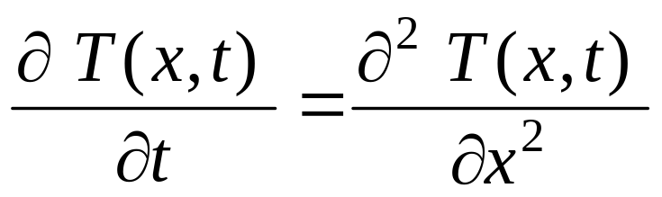
Simpler Heat Equation
x
T(x,t) is used to represent the temperature at time t at the point x of the thin rod.

Slide 11
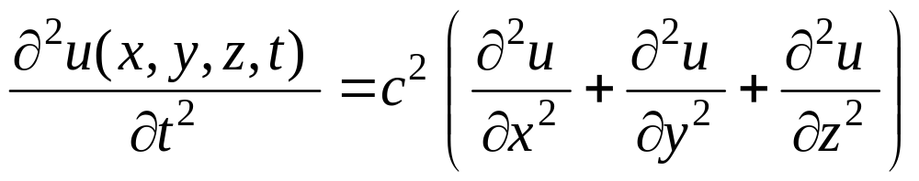
Wave Equation
The function u(x,y,z,t) is used to represent the displacement at time t of a particle whose position at rest is (x,y,z) .
The constant c represents the propagation speed of the wave.

Slide 12
Classification of PDEs
Linear Second order PDEs are important sets of equations that are used to model many systems in many different fields of science and engineering.
Classification is important because:
  Each category relates to specific engineering problems.
  Different approaches are used to solve these categories.

Slide 13
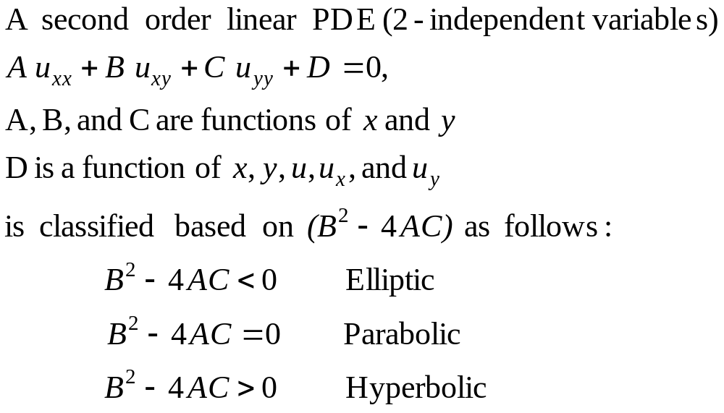
Linear Second Order PDEs
Classification

Slide 14
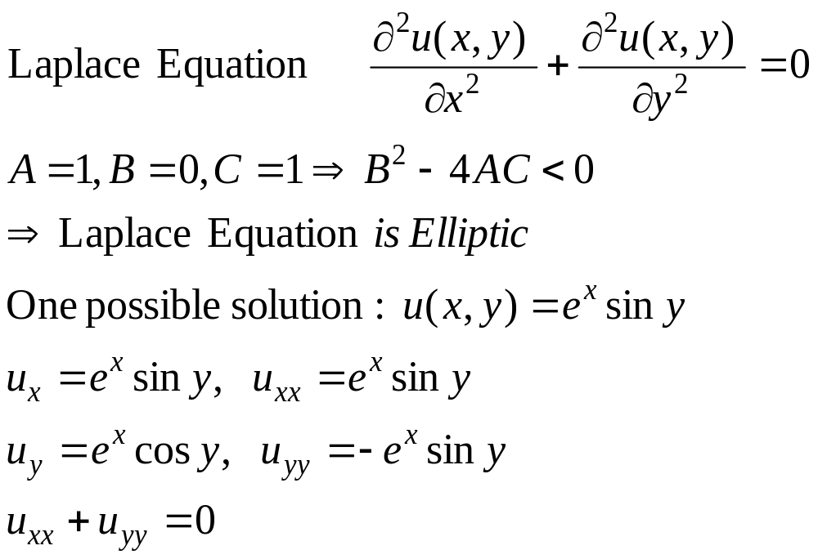
Linear Second Order PDE
Examples (Classification)

Slide 15
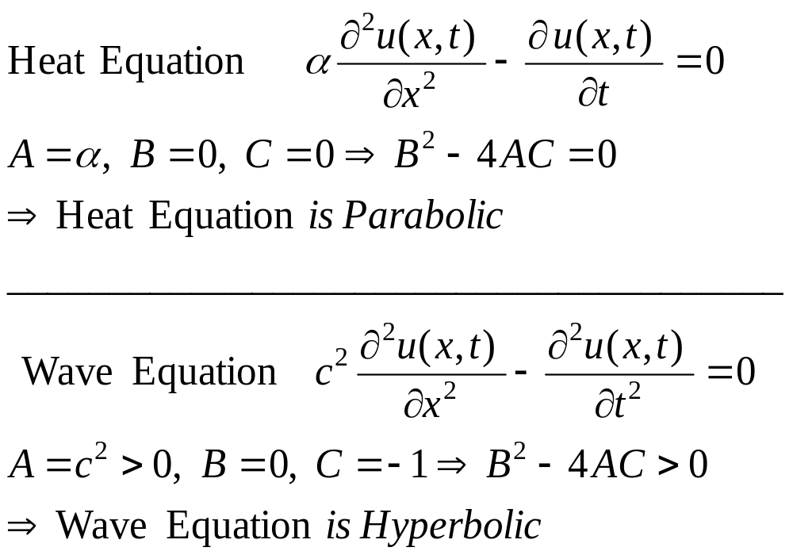
Linear Second Order PDE
Examples (Classification)

